Slide 1
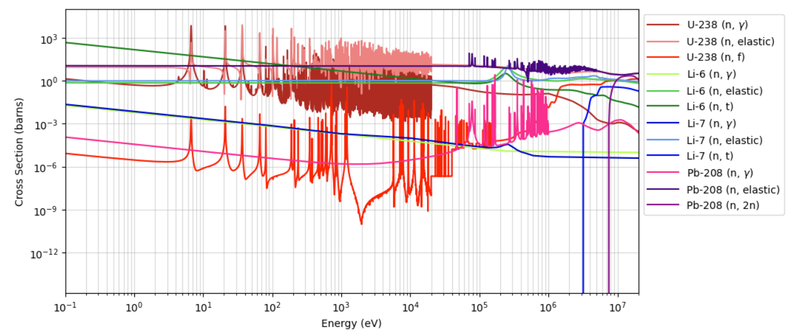
Problem. Downloaded ENDF cross section (xs) data are discrete → need to make them continuous
Space of possible solutions.
(1) NJOY (“en-joy”) is the code used by MCNP to reconstruct ENDF data into continuous xs.
Naïve
Ideal
Linearly interpolate between given data points (“connect-the-dots”)
Various interpolation methods in Python
Use RECONR¹ or OpenMC
Considerations.
1. ENDF data normalized to different laboratory speeds depending on source (e.g., KAERI evaluates for 0 K by default)
Not really a “problem” but more “need to keep track of”
2. Resonances very sharp
Chosen/Implemented solution. Tried various generic interpolation methods but decided to reverse-engineer OpenMC’s way

Slide 2
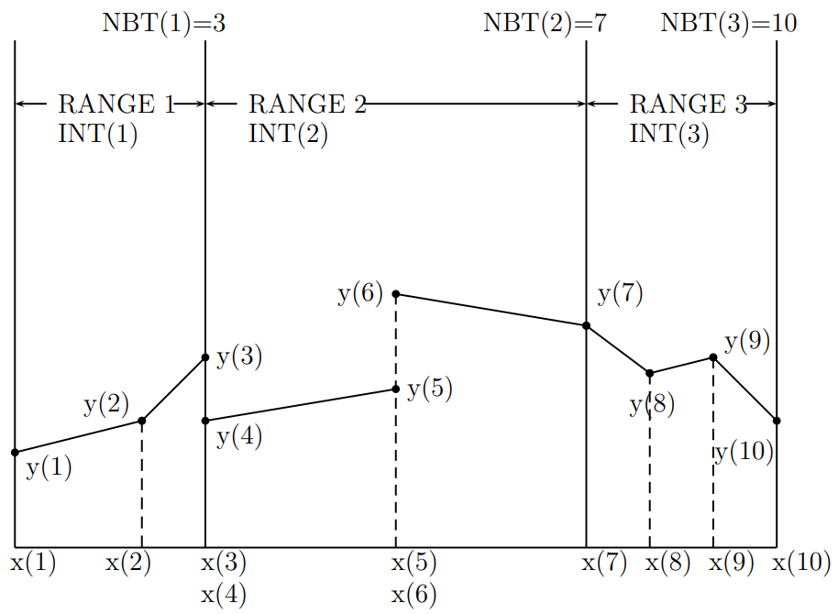
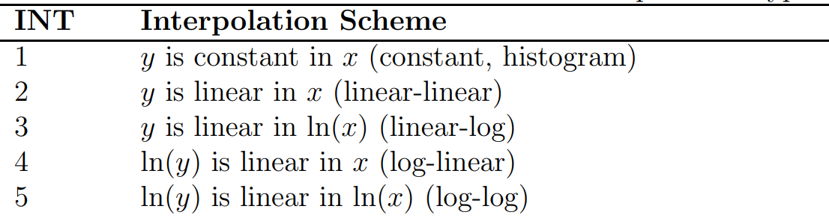
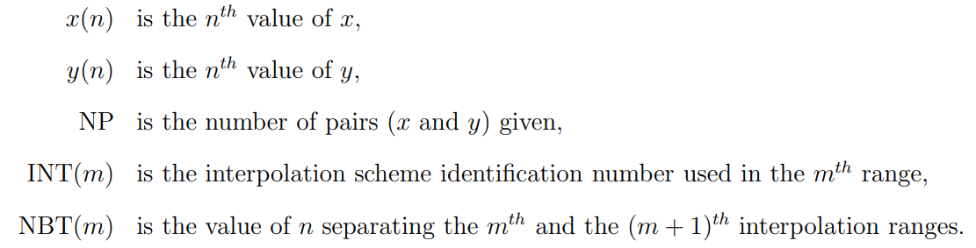
ENDF has an “official” way its cross sections are to be interpolated.
Energies divided up into multiple ranges, and each range is assigned an interpolation scheme (INT)
MCNP’s RECONR and OpenMC uses this
OpenMC code is open-source so we borrow the part of their code that interpolates ENDF
Resolving these slight discontinuities is worked on at BNL but practically aren’t a problem for us
BNL Cross Sections Evaluation Working Group (CSEWG)
Report BNL-90365-2009 Rev.1, CSEWG Document ENDF-102, pp.24-25

Slide 3
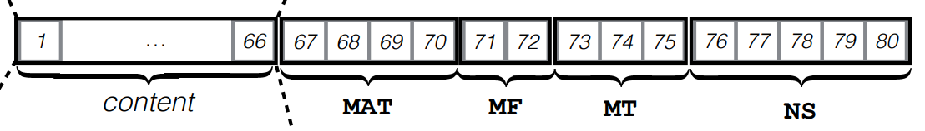
ENDF-102, p.31

Slide 4
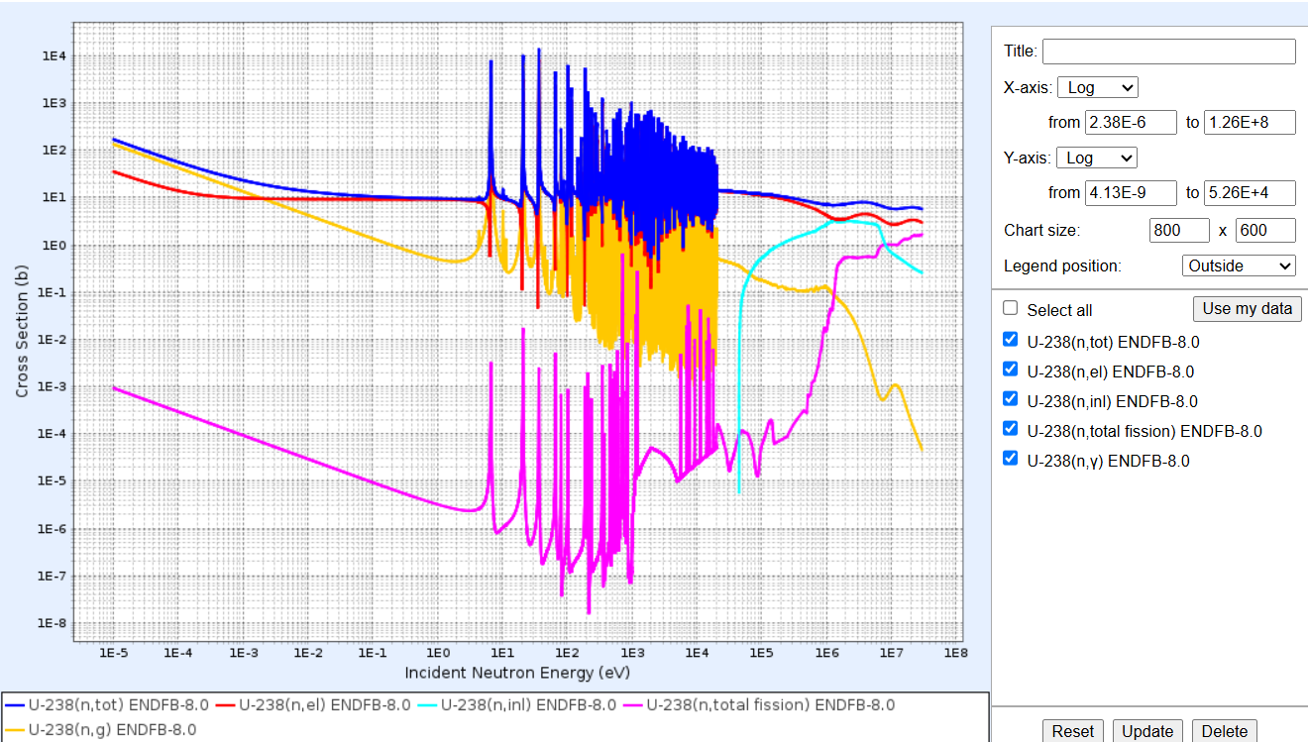

Slide 5
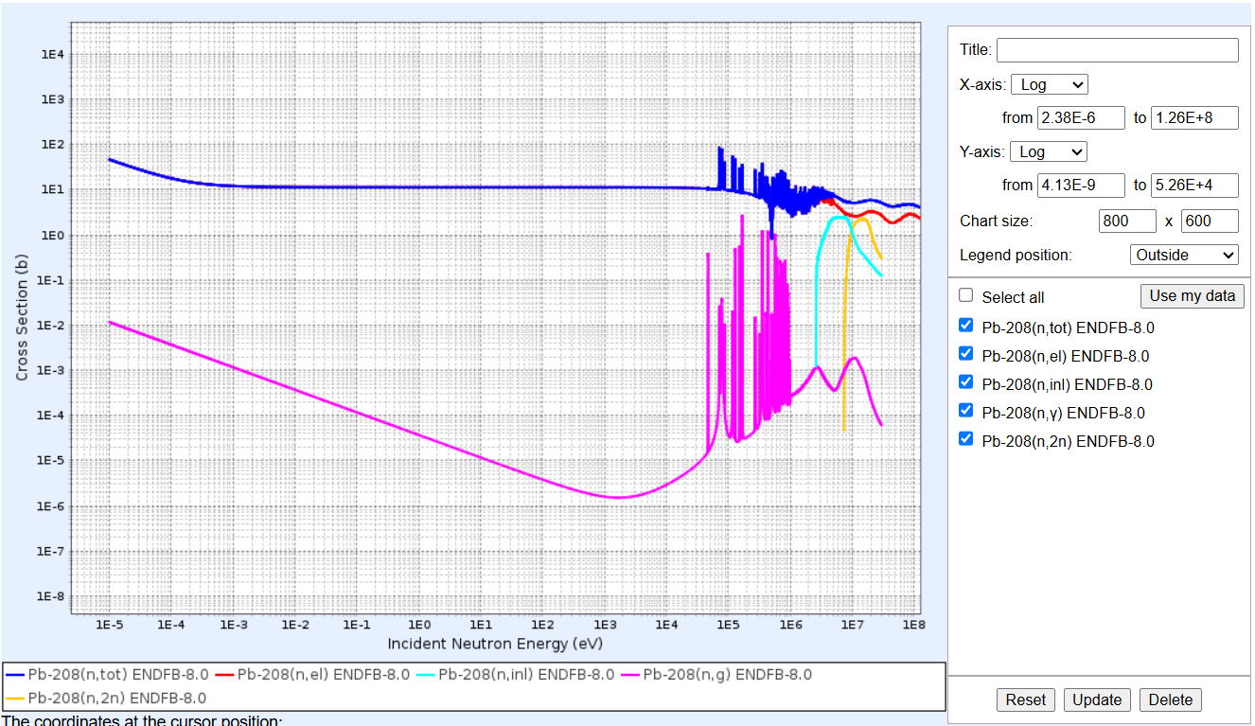

Slide 6
